Slide 1
Magnet STEM Institute Pathways
STEM AT A GLANCE TOPICS: AEROSPACE ENGINEERIG
PETROLIUM ENGINEERING
HEALTH SCIENCE
COMPUTER PROGRAMING
PROJECT LEAD THE WAY CURRICULIUM &SYSTEMS GO
NASA ON CAMPUS
PROJECT BASED LEARNING (PBL) IN THE CLASSROOM
BP AMBASSADOR PROJECT
BE TAUB HOSPITAL
HCC
University of Houston
Rice University
Pumps and Pips
Chevron
NASA
Walgreens

Slide 2
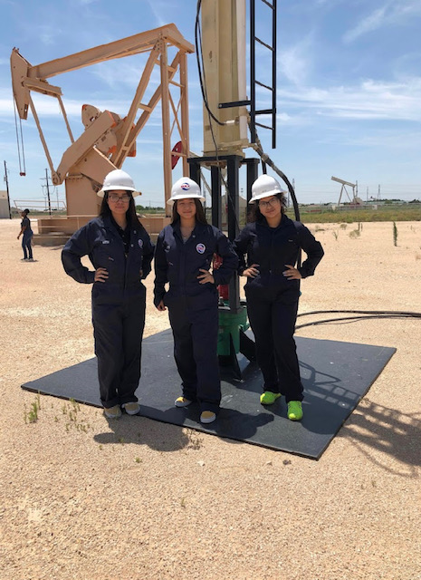
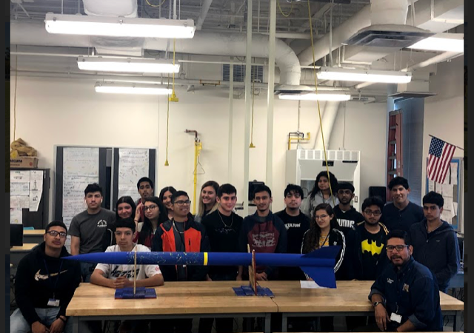
Aerospace & Energy & Petroleum Engineering
Course Sequence
Principles of Applied Engineering
(Choose Aerospace or Petroleum)
Engineering Design I or Aerospace and Design Presentation I
Engineering Design II or Aerospace Design Presentation II
Engineering Design and Problem Solving II or Aerospace Engineering Design and Problem Solving II
Engineering Technology Foundations or Certified SOLIDWORKS Associate(CSWA)- Mechanical Design

Slide 3
Health Science
Course Sequence
Medical Assistant/Pharmacy Tech.
Principles of Health Science
Medical Terminology/Pharmacy I
Health Science Theory with Clinical/Pharmacy II
Practicum in Health Science/Pharmacy Tech
(Field experience in health science is done during hospital rotations/Walgreens Internship)
Certified Clinical Medical Assistant or Pharmacy Tech Certifications

Slide 4
STEM Entrepreneurship
STEM Entrepreneurship
(Small Business/rigor in STEM)
Business Information Management 1
Entrepreneurship 1
Mobile Application Development
Practicum of Entrepreneurship 2
Entrepreneurship and Small Business and Word Specialist

Slide 5
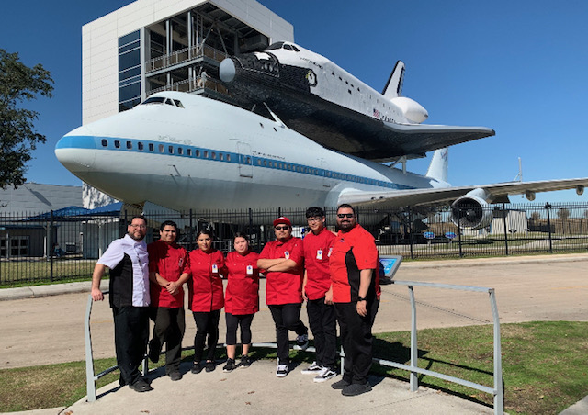
CTE Programs
Culinary Arts
Cosmetology
Welding
HVAC

